Slide 1
HAM iminuit & Multinest Results
Jiaxi
25 May

Slide 2
NOTE：
The parameters are sigma for scattering Vpeak; vcut for cutting large scattering Vpeak end; prior: sigma [0,1]; vcut [100,1000]
Multinest results are analyzer.get_bestfit()['parameters'], errors are not provided because they may not be reliable
Vpeak distribution functions present the average of 15 realisations with the best fitting results

Slide 3
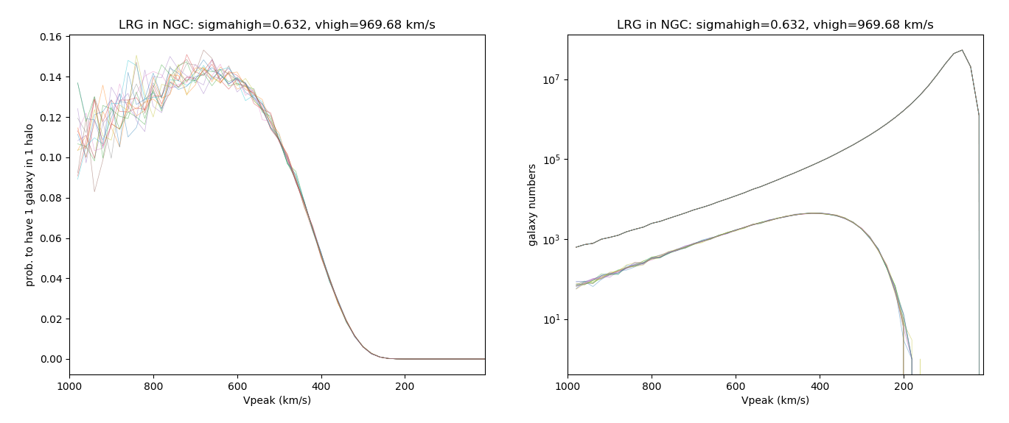
NOTE：
The parameters are sigma for scattering Vpeak; vcut for cutting large scattering Vpeak end
Multinest results are parameter.mean, errors are parameter.err
Multinest errors are considered instead of iminuit because all iminuit results are not converged (Hesse error meaningless)
Galaxy distribution functions present 10 realisations with the best fitting results
UNIT Vpeak distr.
best-fit Vpeak distr.
UNIT Vpeak distr.
best-fit Vpeak distr.

Slide 4
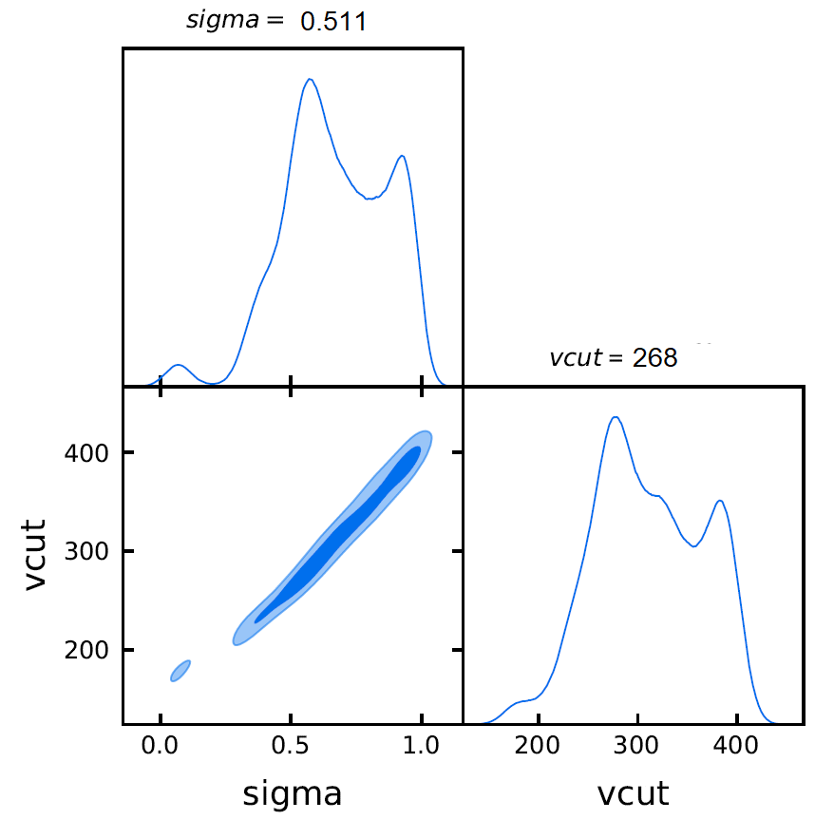
ELG NGC: parameters
Multinest
chi2= 51.886
iminuit
chi2 = 54.50

Slide 5
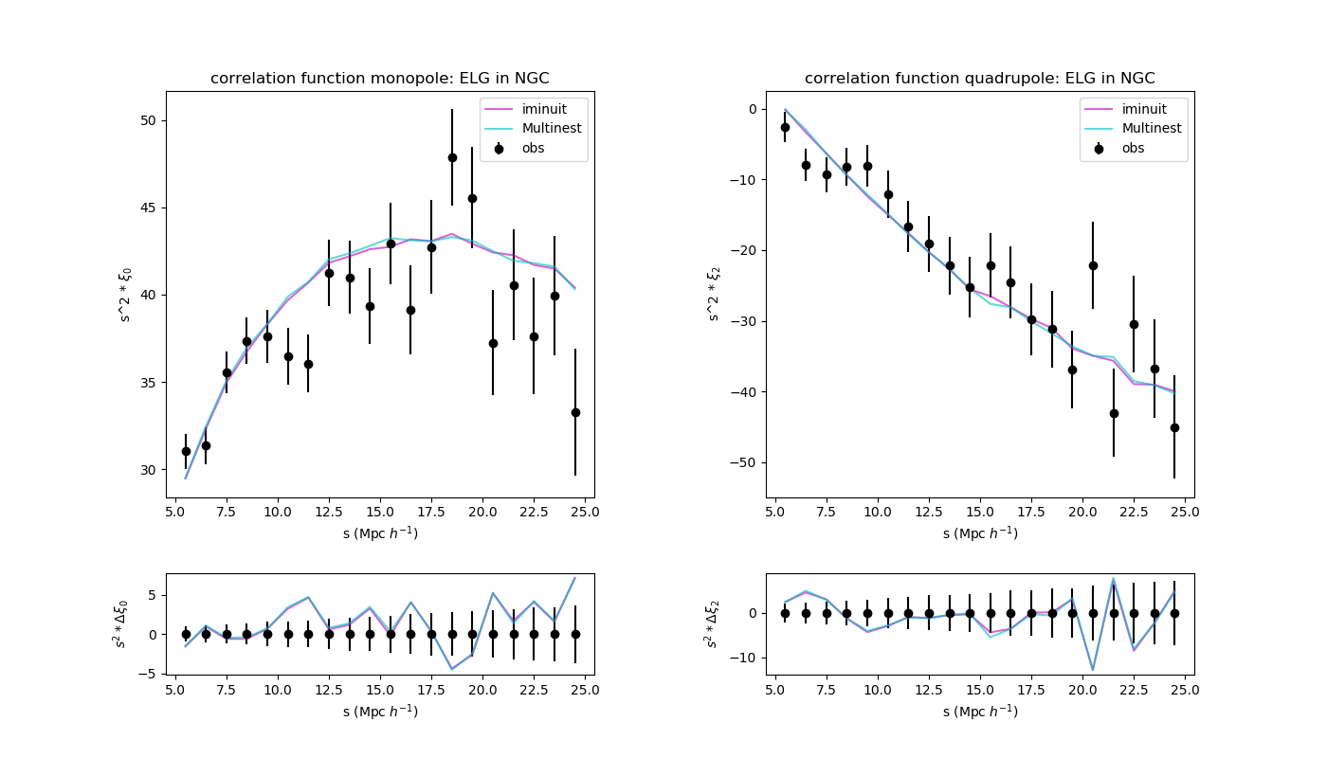
ELG NGC: correlation function

Slide 6
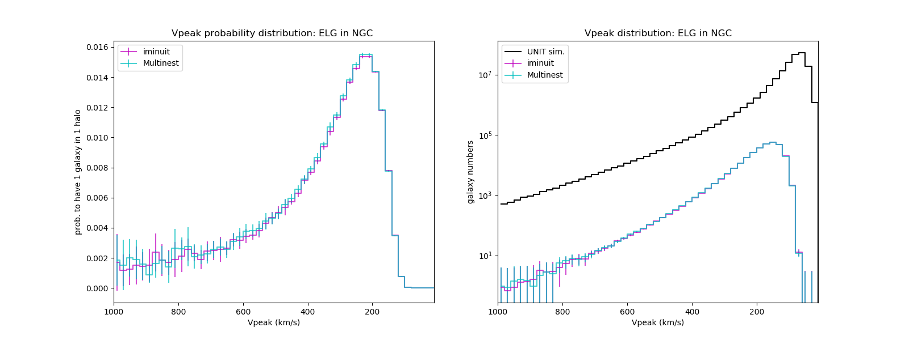
ELG NGC: Vpeak distribution

Slide 7
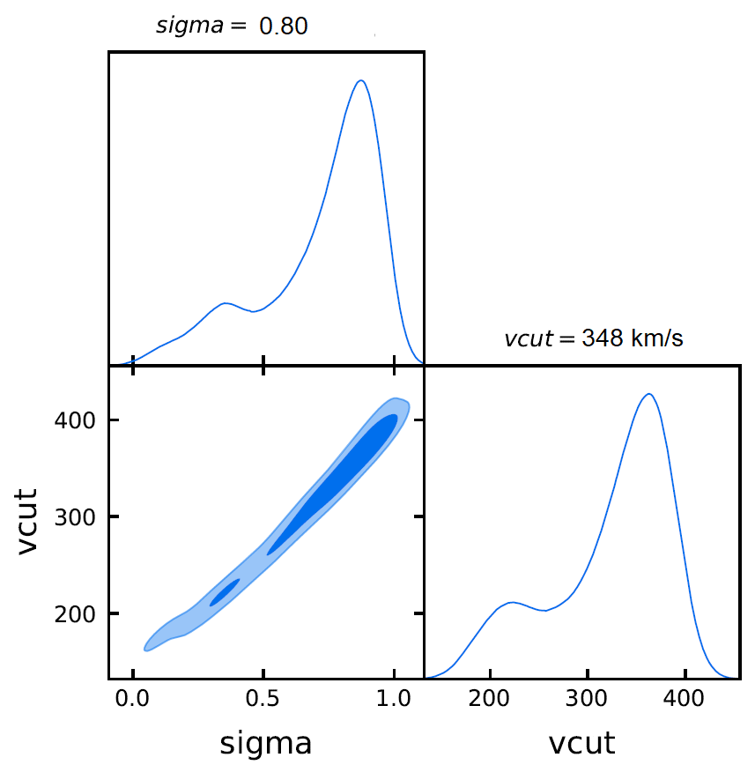
ELG SGC: parameters
Multinest
chi2 = 51.569
iminuit
chi2=53.145

Slide 8
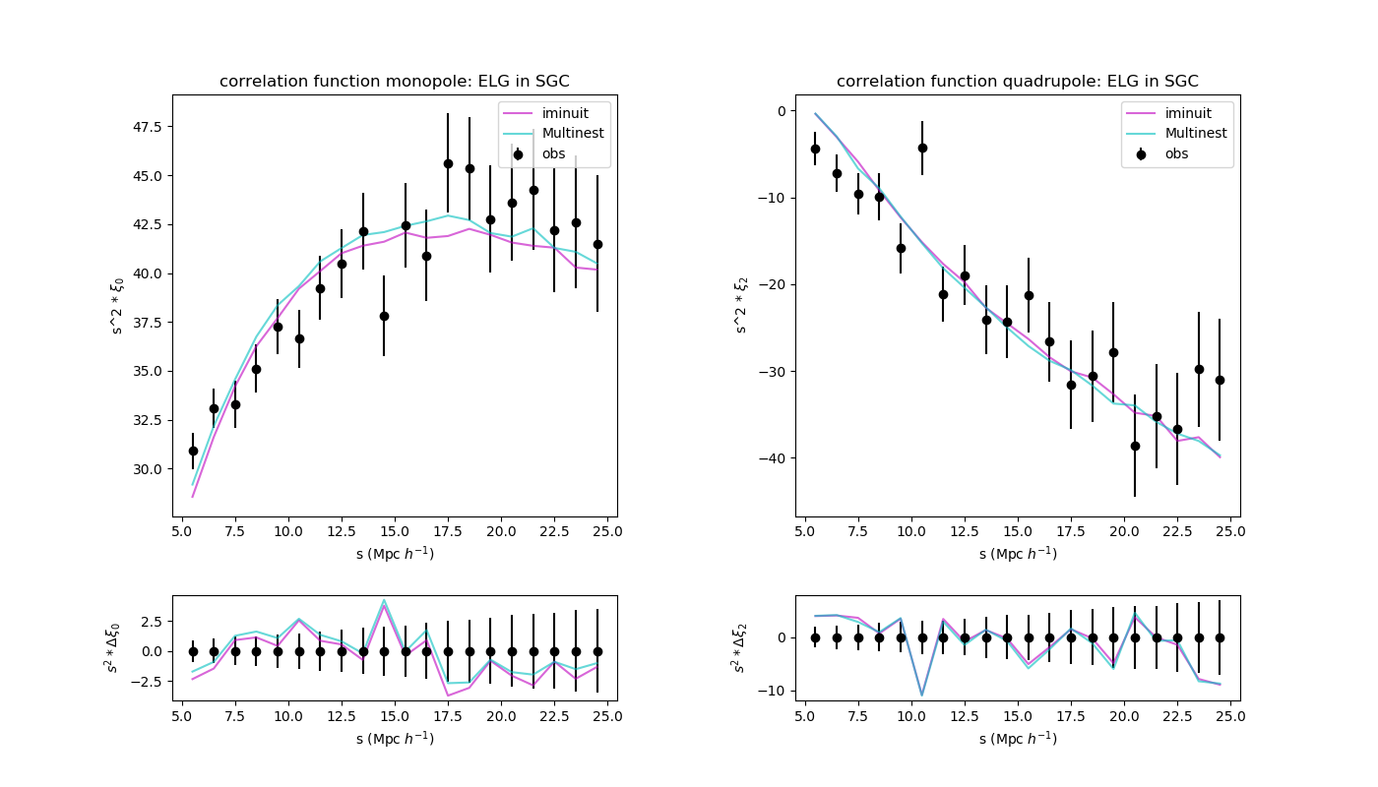
ELG SGC: correlation function

Slide 9
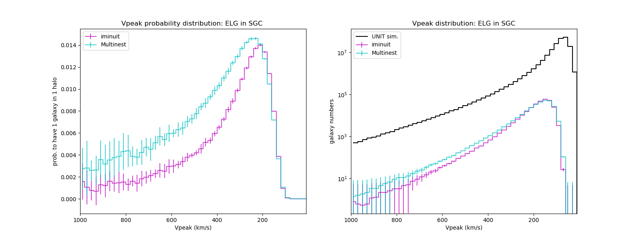
ELG SGC: Vpeak distribution

Slide 10
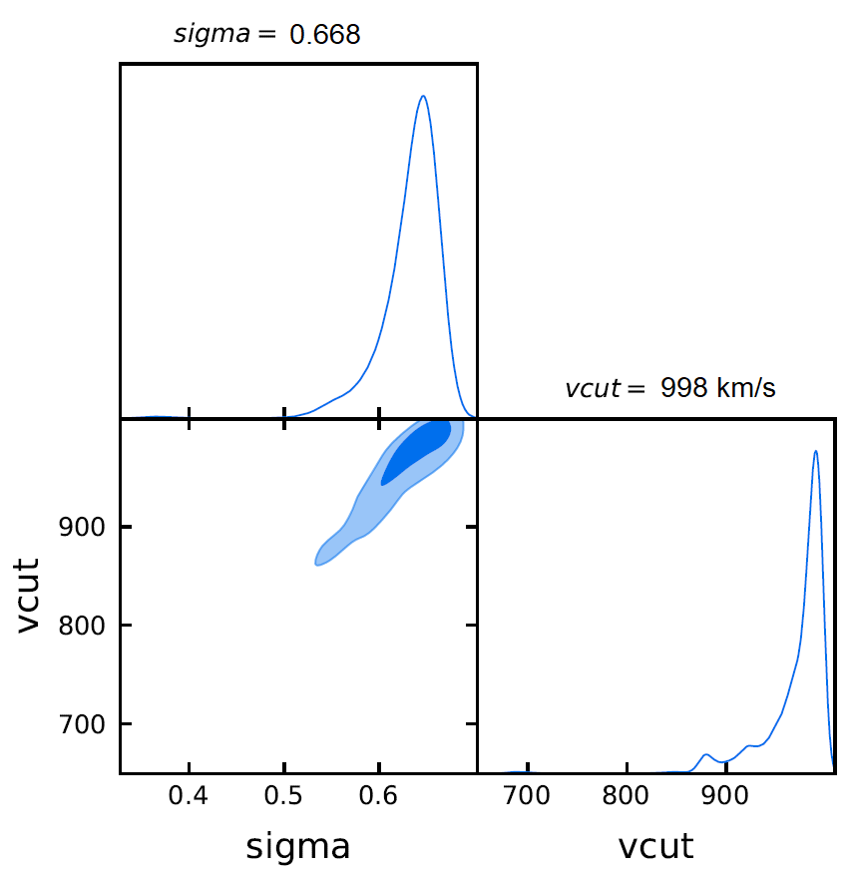
LRG NGC: parameters
Multinest
CHI2 =71.38
iminuit
chi2 = 93.145
(near the prior boundary)

Slide 11
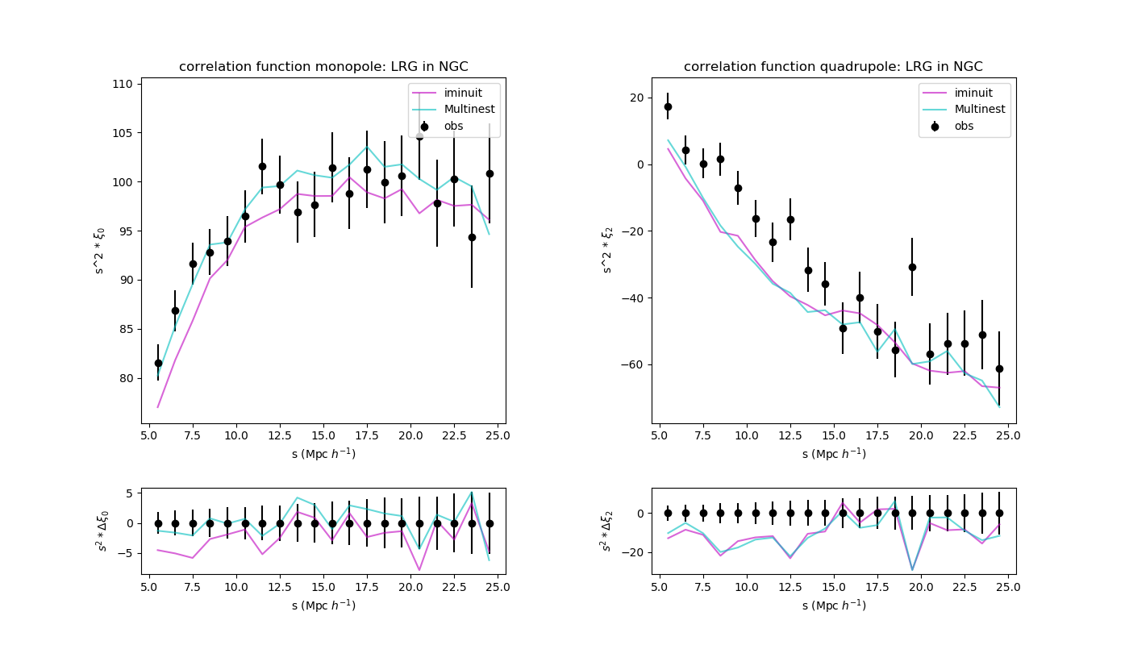
LRG NGC: correlation function

Slide 12
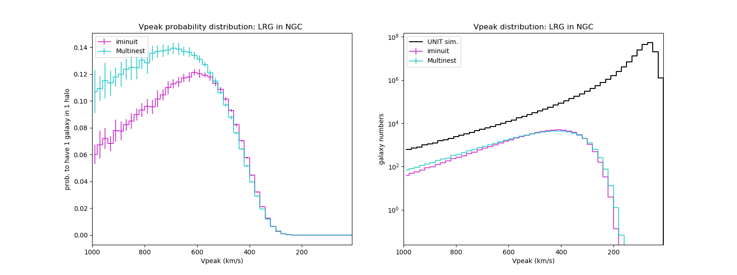
LRG NGC: Vpeak distribution

Slide 13
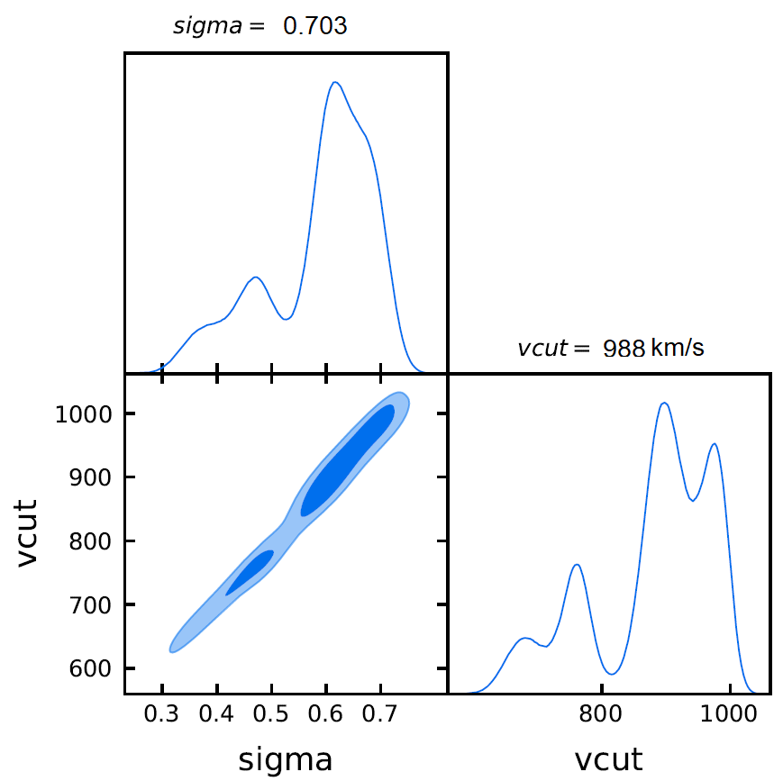
LRG SGC: parameters
iminuit
chi2 = 130.777
Multinest
CHI2=63.194
(near the prior boundary)
(near the prior boundary)

Slide 14
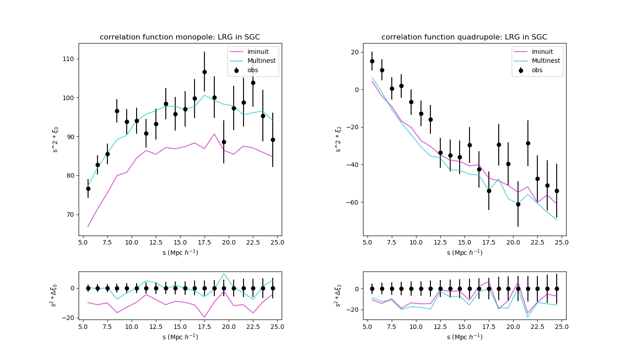
LRG SGC: correlation function

Slide 15
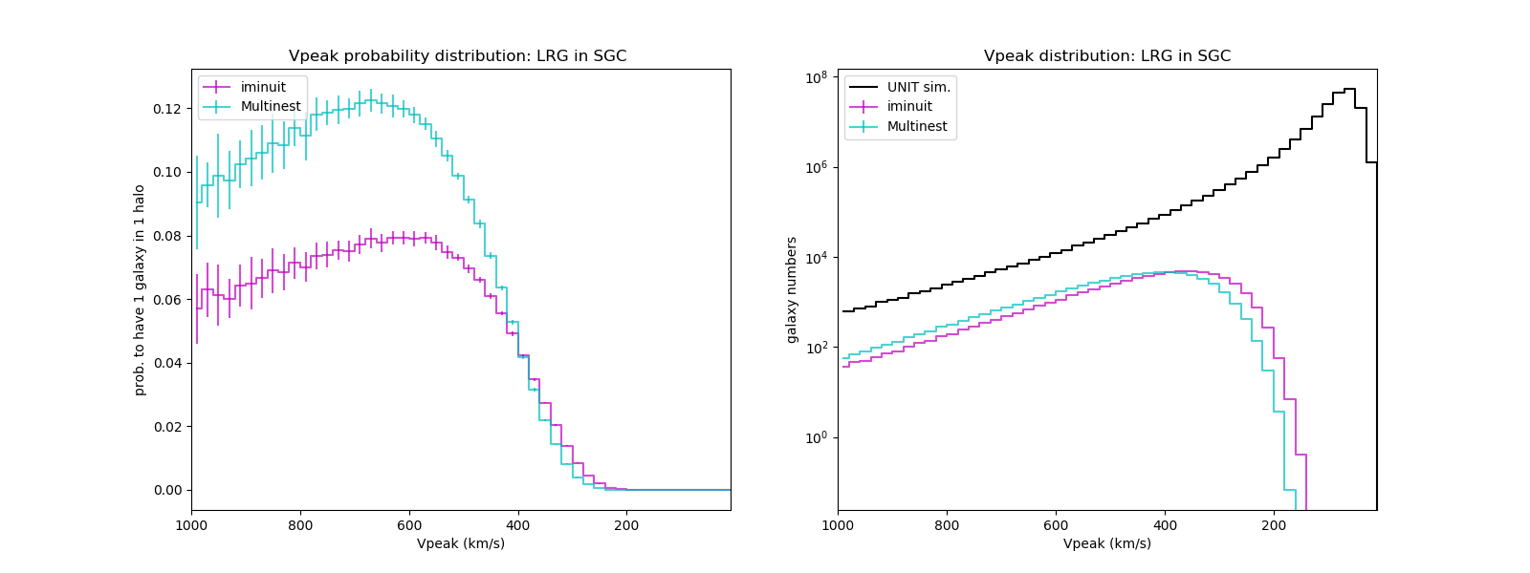
LRG SGC: Vpeak distribution

Slide 16
Conclusions：
Monopoles are sensitive to parameters while quadrupoles are not
Multinest & iminuit results are not consistent except the ELG NGC result.
iminuit LRG SGC results seems unrealiable because it hits the boundary
Due to the non-Guassian shape posterior, may be it is not appropriate to determine results as parameter.mean, errors as parameter.err

